Slide 1
<<Software Engineering Lab>>
Instructor : Dr. Arash Kosari
References:
M. Fowler. Analysis Patterns: Reusable Object Models. Addison-Wesley, 1996.
M. Fowler. Refactoring: Improving the Design of Existing Code. Addison-Wesley, 1999.
M. Fowler. UML Distilled. 3rd Edition, Addison-Wesley, 2004.
E. Gamma, R. Helm, R. Johnson, J. Vlissides. Design Patterns: Elements of Reusable Object-Oriented Software. Addison-Wesley, 1995.
C. Larman. Applying UML and Patterns: An Introduction to Object-Oriented Analysis and Design and Iterative Development. 3rd Edition, Prentice-Hall, 2004.

Slide 2
There are 6 main title in the laboratory:
Analysis
Designing
Implementation
Unit Testing
Testing Techniques
Final meeting and summary
Preparation of laboratory report:
Work reports should be in the form of scientific reports
The laboratory work report is evaluated by the instructor and students.

Slide 3
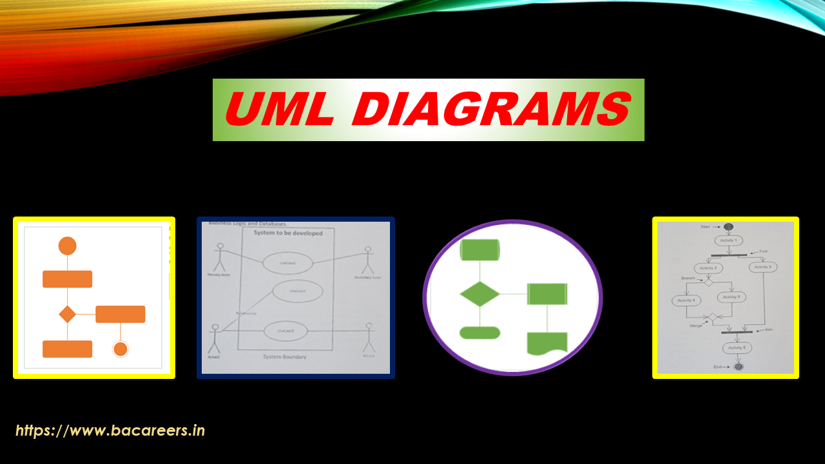
What is UML?
UML, short for Unified Modeling Language, is a standardized modeling language consisting of an integrated set of diagrams, developed to help system and software developers for specifying, visualizing, constructing, and documenting the artifacts of software systems, as well as for business modeling and other non-software systems.
The UML is a very important part of developing object oriented software and the software development process. The UML uses mostly graphical notations to express the design of software projects.

Slide 4
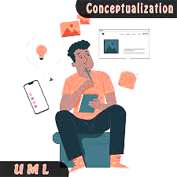
Why UML
These techniques include component technology, visual programming, patterns and frameworks. Businesses also seek techniques to manage the complexity of systems as they increase in scope and scale.
In particular, they recognize the need to solve recurring architectural problems, such as physical distribution, concurrency, replication, security, load balancing and fault tolerance. Additionally, the development for the World Wide Web, while making some things simpler, has intensifiy these architectural problems. The Unified Modeling Language (UML) was designed to respond to these needs.
Notes:
As the strategic value of software increases for many companies, the industry looks for techniques to automate the production of software and to improve quality and reduce cost and time-to-market.

Slide 5
As UML describes the real-time systems, it is very important to make a conceptual model and then proceed gradually. The conceptual model of UML can be mastered by learning the following three major elements :
UML building blocks
Rules to connect the building blocks
Common mechanisms of UML
This chapter describes all the UML building blocks. The building blocks of UML can be defined as :
Things
Relationships
Diagrams
Things
Things are the most important building blocks of UML. Things can be −
Structural
Behavioral
Grouping
Annotational
AD

Slide 6




Structural Things
Structural things define the static part of the model. They represent the physical and conceptual elements. Following are the brief descriptions of the structural things.
Class − Class represents a set of objects having similar responsibilities.
Interface − Interface defines a set of operations, which specify the responsibility of a class.
Collaboration −Collaboration defines an interaction between elements.
Use case −Use case represents a set of actions performed by a system for a specific goal.

Slide 7


Component −Component describes the physical part of a system.
Node − A node can be defined as a physical element that exists at run time.

Slide 8




Behavioral Things
A behavioral thing consists of the dynamic parts of UML models. Following are the behavioral things −
Interaction − Interaction is defined as a behavior that consists of a group of messages exchanged among elements to accomplish a specific task.
State machine − State machine is useful when the state of an object in its life cycle is important.
It defines the sequence of states an object goes through in response to events. Events are external factors responsible for state change
Grouping Things
Grouping things can be defined as a mechanism to group elements of a UML model together. There is only one grouping thing available −
Package − Package is the only one grouping thing available for gathering structural and behavioral things.
Annotational Things
Annotational things can be defined as a mechanism to capture remarks, descriptions, and comments of UML model elements.
Note - It is the only one Annotational thing available. A note is used to render comments, constraints, etc. of an UML element.

Slide 9
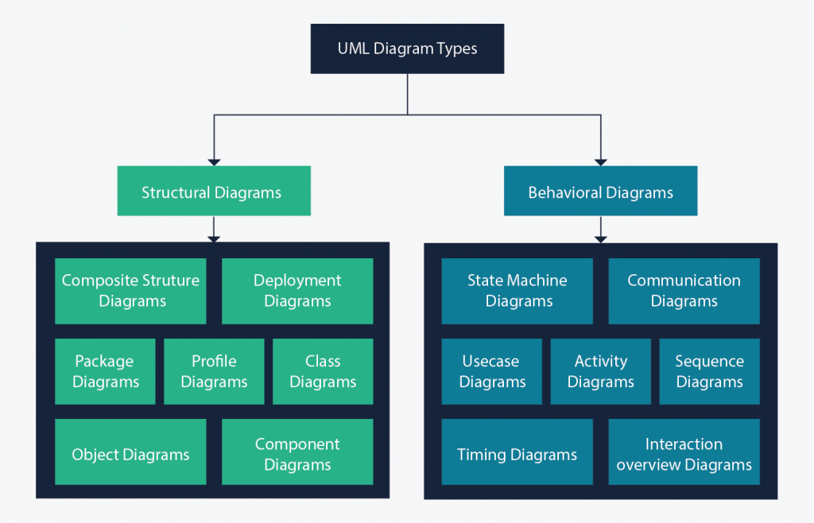
UML Diagrams
UML diagrams are the ultimate output of the entire discussion. All the elements, relationships are used to make a complete UML diagram and the diagram represents a system.
The visual effect of the UML diagram is the most important part of the entire process. All the other elements are used to make it complete.
UML includes the following nine diagrams, the details of which are described in the subsequent chapters.
Class diagram
Object diagram
Use case diagram
Sequence diagram
Collaboration diagram
Activity diagram
Statechart diagram
Deployment diagram
Component diagram

Slide 10
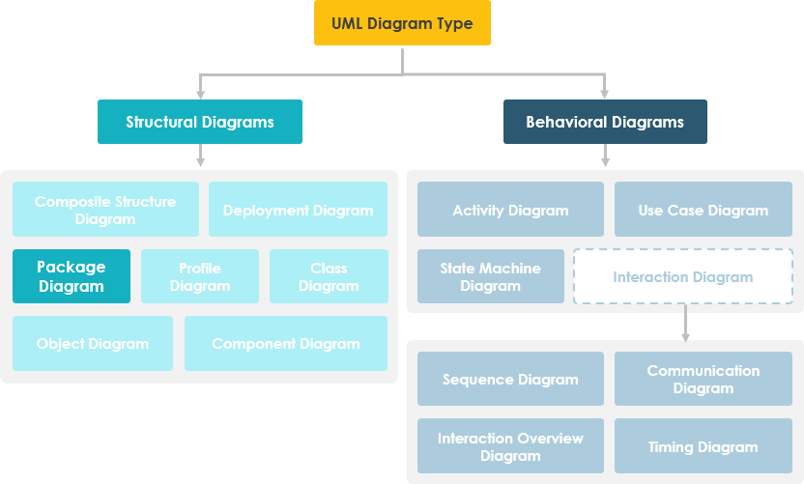
What is Package Diagram?
Package diagram, a kind of structural diagram, shows the arrangement and organization of model elements in middle to large scale project. Package diagram can show both structure and dependencies between sub-systems or modules, showing different views of a system, for example, as multi-layered (aka multi-tiered) application - multi-layered application model.

Slide 11
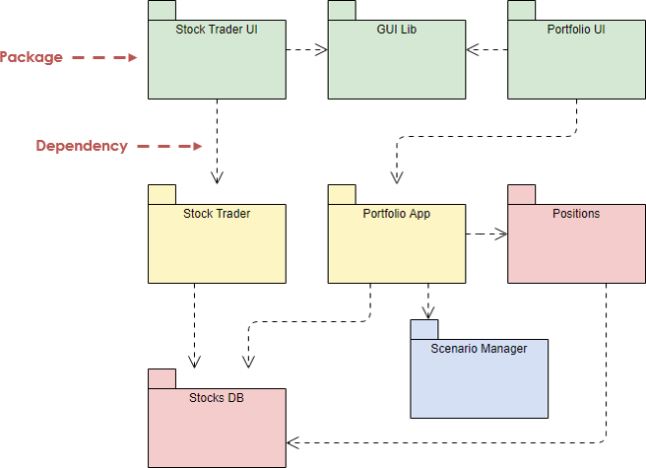
Purpose of Package Diagrams
- Package diagrams are used to structure high level system elements. Packages are used for organizing large system which contains diagrams, documents and other key deliverables.
- Package Diagram can be used to simplify complex class diagrams, it can group classes into packages.
- A package is a collection of logically related UML elements.
- Packages are depicted as file folders and can be used on any of the UML diagrams.

Slide 12
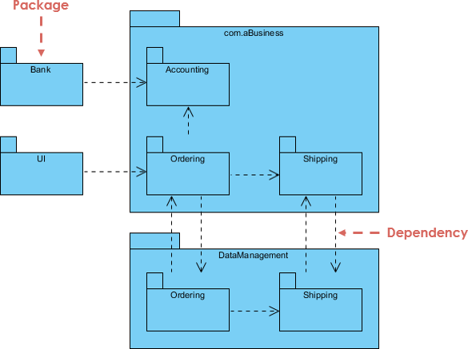
Package Diagram at a Glance
Package diagram is used to simplify complex class diagrams, you can group classes into packages. A package is a collection of logically related UML elements.
The diagram below is a business model in which the classes are grouped into packages:
Packages appear as rectangles with small tabs at the top.
The package name is on the tab or inside the rectangle.
The dotted arrows are dependencies.
One package depends on another if changes in the other could possibly force changes in the first.

Slide 13
UML Class Diagram
The UML Class diagram is a graphical notation used to construct and visualize object oriented systems. A class diagram in the Unified Modeling Language (UML) is a type of static structure diagram that describes the structure of a system by showing the system's:
classes,
their attributes,
operations (or methods),
and the relationships among objects.
------------------------------------------------------
What is a Class?
A Class is a blueprint for an object. Objects and classes go hand in hand. We can't talk about one without talking about the other. And the entire point of Object-Oriented Design is not about objects, it's about classes, because we use classes to create objects. So a class describes what an object will be, but it isn't the object itself.
Notes:
In fact, classes describe the type of objects, while objects are usable instances of classes. Each Object was built from the same set of blueprints and therefore contains the same components (properties and methods). The standard meaning is that an object is an instance of a class and object - Objects have states and behaviors.

Slide 14
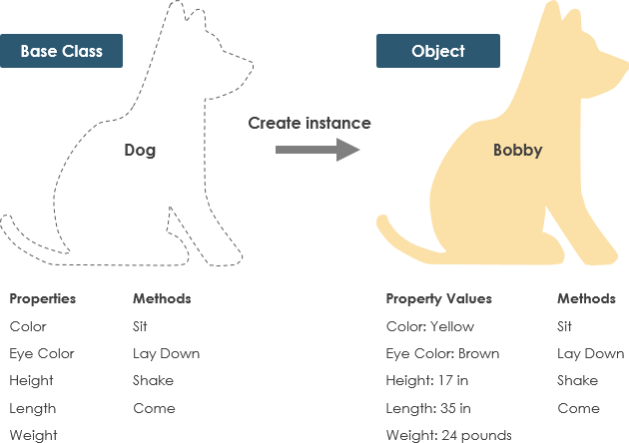
Example
A dog has states - color, name, breed as well as behaviors -wagging, barking, eating. An object is an instance of a class.

Slide 15
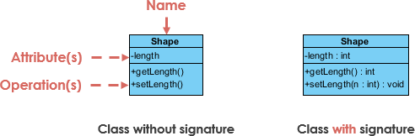
UML Class Notation
A class represent a concept which encapsulates state (attributes) and behavior (operations). Each attribute has a type. Each operation has a signature. The class name is the only mandatory information.
- Class Name:
The name of the class appears in the first partition.
- Class Attributes:
Attributes are shown in the second partition.
The attribute type is shown after the colon.
Attributes map onto member variables (data members) in code.
- Class Operations (Methods):
Operations are shown in the third partition. They are services the class provides.
The return type of a method is shown after the colon at the end of the method signature.
The return type of method parameters are shown after the colon following the parameter name. Operations map onto class methods in code

Slide 16
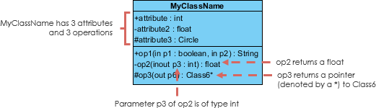
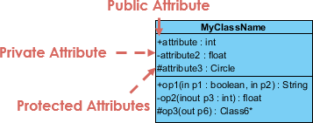
Class Visibility
The +, - and # symbols before an attribute and operation name in a class denote the visibility of the attribute and operation.
+ denotes public attributes or operations
- denotes private attributes or operations
# denotes protected attributes or operations

Slide 17
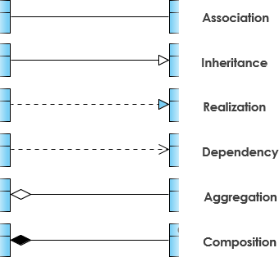
Relationships between classes
UML is not just about pretty pictures. If used correctly, UML precisely conveys how code should be implemented from diagrams. If precisely interpreted, the implemented code will correctly reflect the intent of the designer.

Slide 18
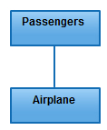
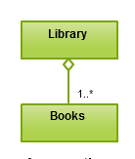
Association
is a broad term that encompasses just about any logical connection or relationship between classes. For example, passengers and airline may be linked as above.
Aggregation
refers to the formation of a particular class as a result of one class being aggregated or built as a collection. For example, the class “library” is made up of one or more books, among other materials. In aggregation, the contained classes are not strongly dependent on the lifecycle of the container.

Slide 19
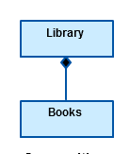
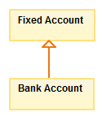
Composition
The composition relationship is very similar to the aggregation relationship. with the only difference being its key purpose of emphasizing the dependence of the contained class to the life cycle of the container class. That is, the contained class will be obliterated when the container class is destroyed.
Inheritance / Generalization
refers to a type of relationship wherein one associated class is a child of another by virtue of assuming the same functionalities of the parent class. In other words, the child class is a specific type of the parent class. To show inheritance in a UML diagram, a solid line from the child class to the parent class is drawn using an unfilled arrowhead.

Slide 20
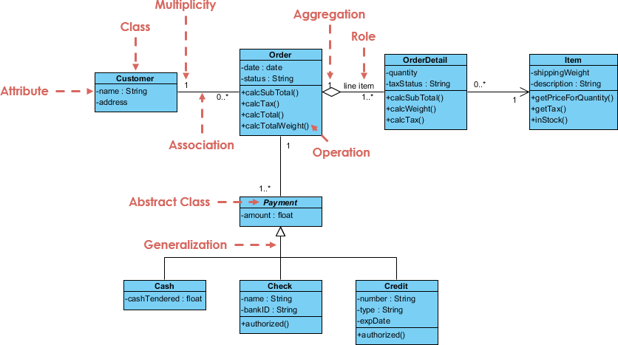
Class Diagram Example: Order System

Slide 21
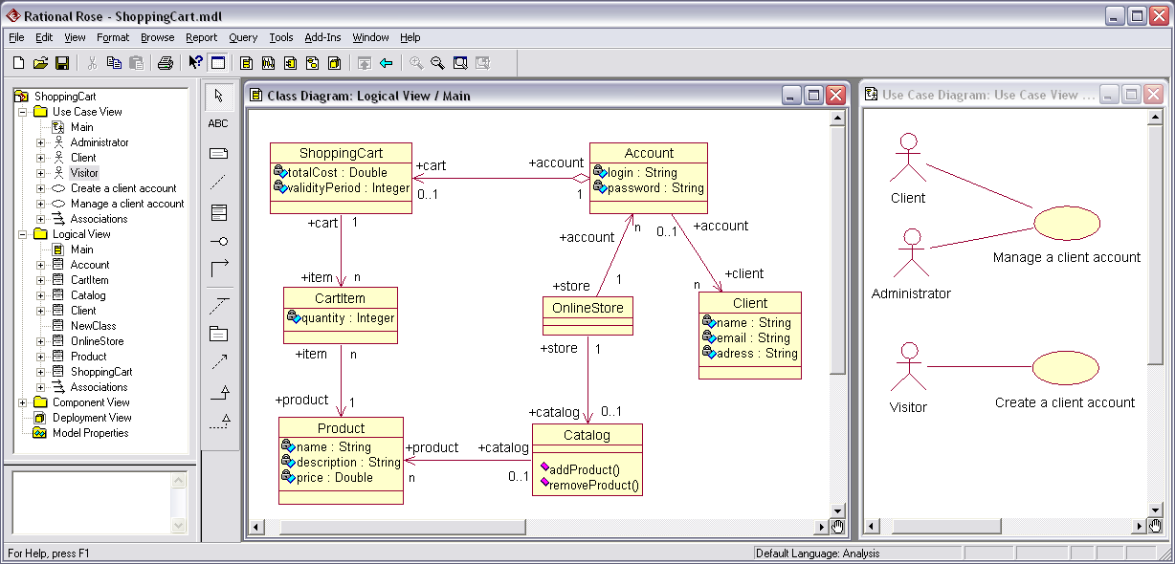

Rational Rose
What Does Rational Rose Mean?
Rational Rose is an object-oriented programming (OOP) and unified modeling language (UML) tool to design enterprise-level software applications and components. It creates visual software application models under object-oriented principles. Example application models include the creation of actors, use cases, relationships, objects, entities, etc. Rational Rose uses classical UML concepts to graphically model software applications. This facilitates documenting the environment, requirements and overall design.
Rational Rose is a powerful graphical user interface (GUI) modeling tool using efficient and user-friendly drag and drop and design maneuverability. Certain Rational Rose versions actually produce relevant source code for designed models.

Slide 22
https://p30download.ir/fa/entry/12635/
راهنمای نصب نسخه ی 8:
1- تاریخ سیستم را به سال 2012 تغییر دهید. (مهم)
2- اقدام به نصب نرم افزار کنید.
3- نرم افزار را اجرا کنید. در پنجره مربوط به لایسنس گزینه import a Rational LiLicense را آدرس دهی کنید.
4- به این دلیل که تاریخ انقضای فایل لایسنس این نرم افزار دcense file را انتخاب کنید. سپس فایل alllic.upd موجود در پوشه ر سال 2013 است، برای معتبر بودن لایسنس و اجرا شدن نرم افزار، قبل از اجرا باید تاریخ سیستم خود را برای سال 2012 قرار دهید.

